Slide 1


Buy Online Books
Submitted by
Harshita Mehta(18etccs042)
Pooja Dave(19etccs205)
Payal Patel(18etccs070)
Asha Yadav(18etccs012)

Slide 2

Our project is to create an ecommerce Website(BuyOnlineBooks).
In this Website we can easily Buy or Sale your old or previous books or any other books, it helps us to find books related to any subject, it can be novels, autobiography etc.
It’s a kind of Online library where, student can upload their last year or previous books or old books of different subjects.
The books are easily available to all they can buy books online.
This module provides the details of candidate who is providing books to others , where he can register himself and post available books, and access other books.
Introduction About Project

Slide 3
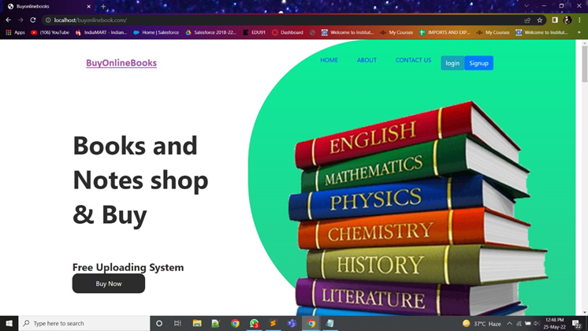
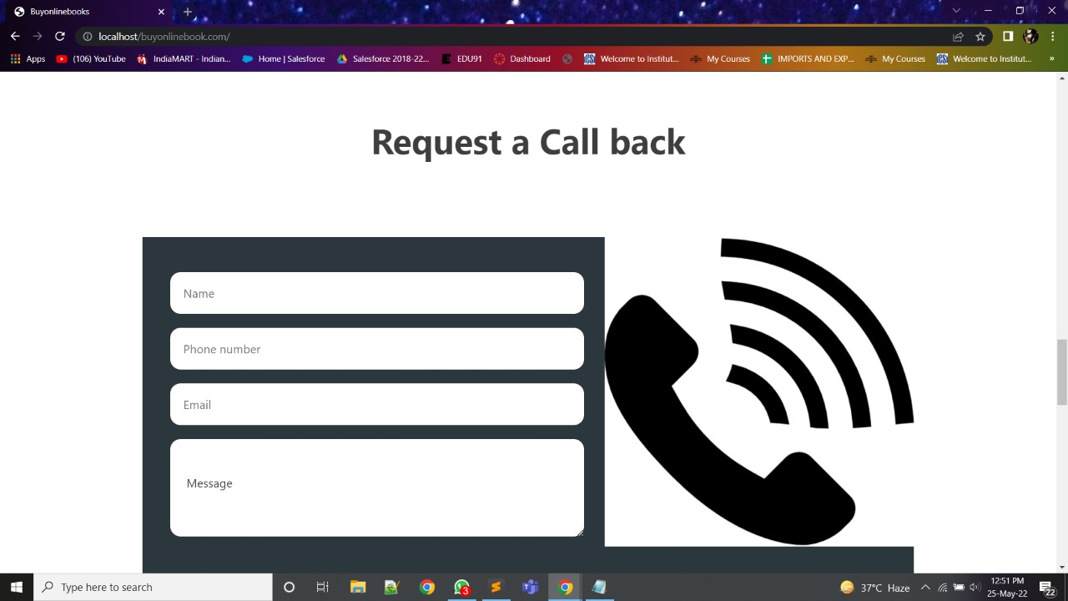
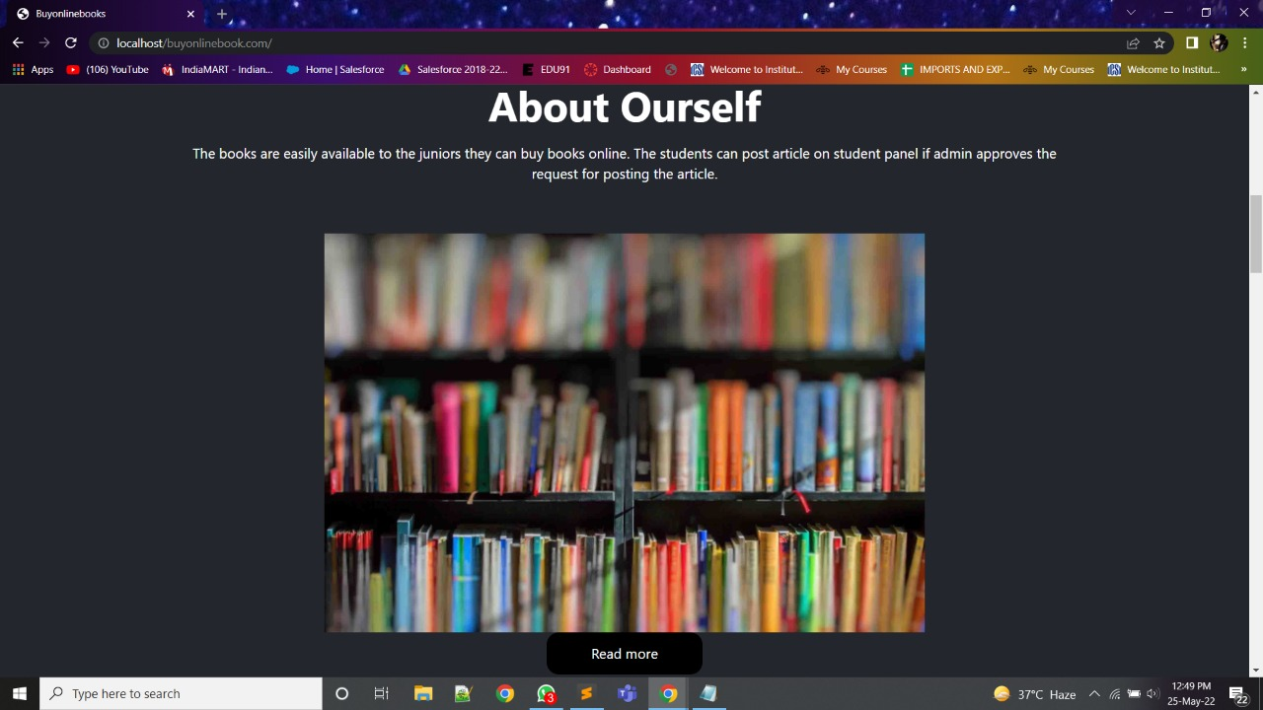

Slide 4
In admin panel admin can upload or delete any book. It contains all the user’s registration information ( name, address, Pincode, contact no., e-mail, password ) It can update user about the order details.
Admin Panel

Slide 5
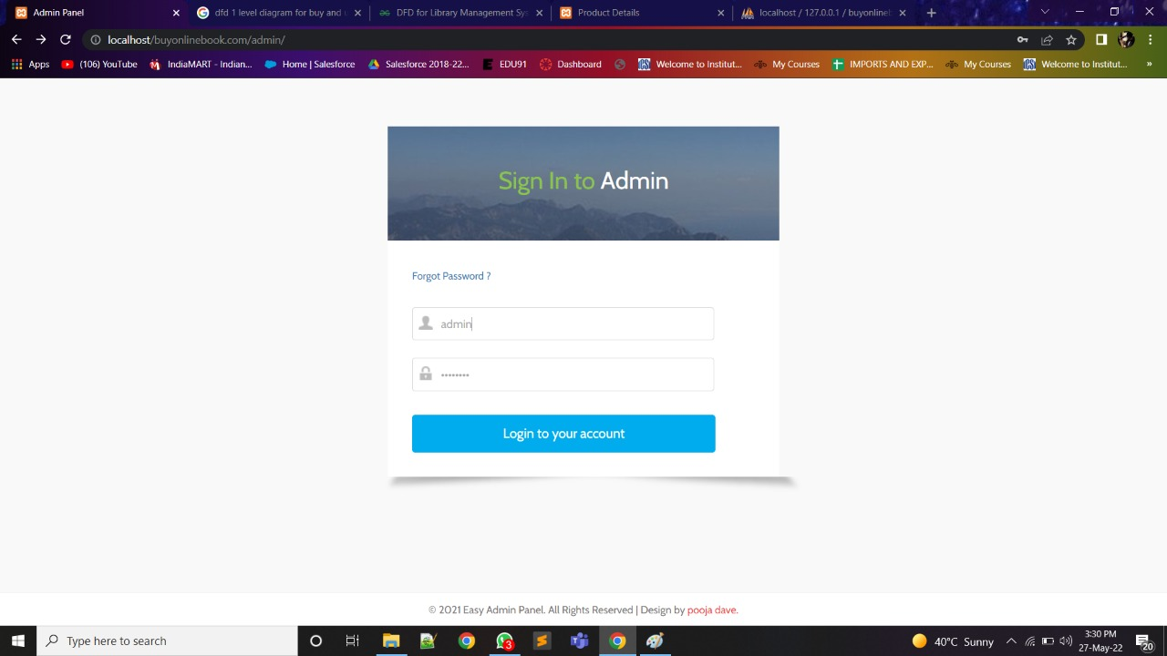

Slide 6
Admin Features of BuyOnlineBooks
Dashboard – For the admin dashboard, you will be able to all the basic access in the whole system. Such as summary of products, orders, and the categories.
Manage Books– The admin has access to the books management information system. He can add, update and delete the books.
Manage Categories – The page where the admin can edit and delete categories information.
Manage Orders – As the main functions of the admin, the admin can accept or reject the order from the customers on a case to case basis and the list of customer orders are listed.
Manage User and Delivery Boy – The admin can manage the user’s account. Admin can add, update and Delete user in the system.
Login and Logout – By default one of the security features of this system is the secure login and logout system.

Slide 7
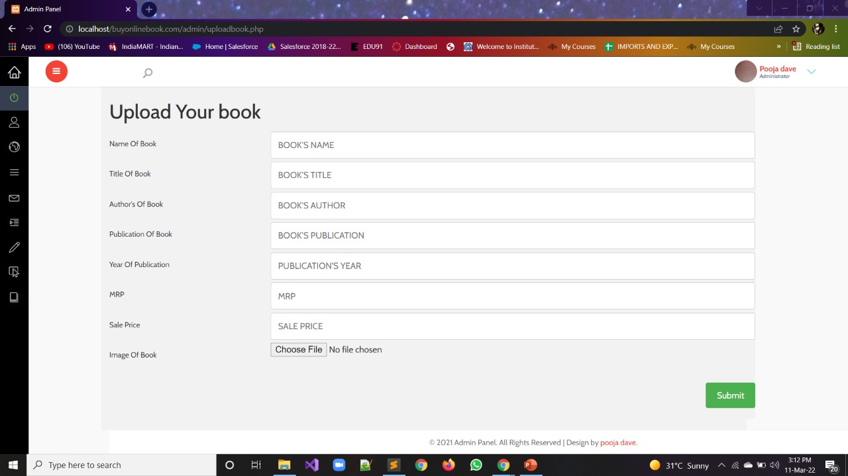
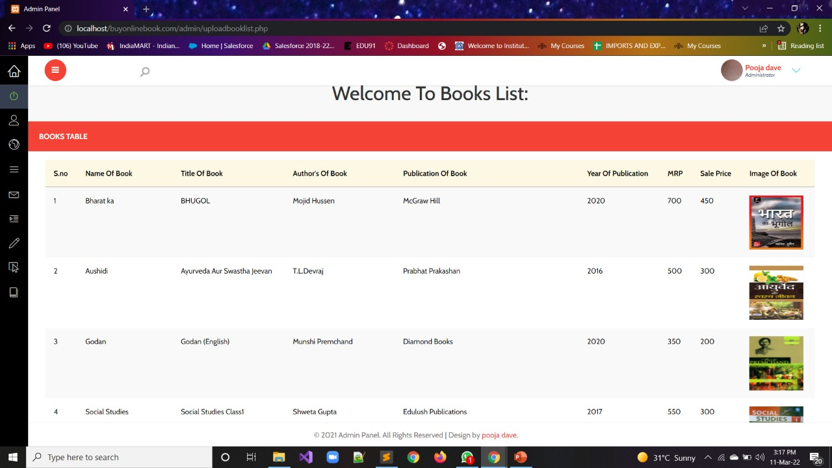
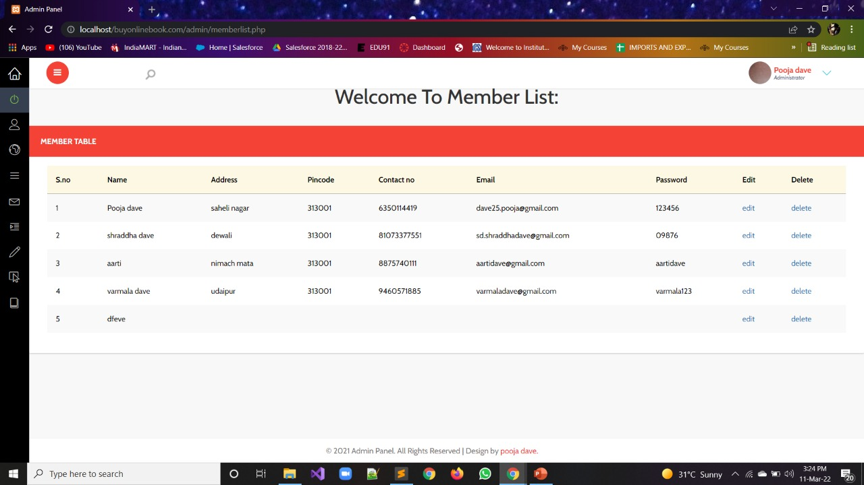


Slide 8
User can visit the website. If user wants to upload or buy any book then he/she has to register first. For registration user needs to provide various information (name, address , Pincode , e-mail, password) To upload any book user need to provide details about that book ( book name, book title, author’s name, publishers name, publication year, cover page of book, MRP, selling price)
User Panel

Slide 9
Customer Features of Online Book
Login Page – Customer enter their website credentials on this page to gain access in order to log in.
Register Page– The page where new customer created their login credentials for the website.
Home Page– When customer visit the website, this is the system’s default page. This page shows the books for sale in the store, or by entering a keyword in the search box above the books.
Book View Page – The page on which the product’s specific information is shown, as well as the page on which the customer buy the books.
Product details page – The page that lists the customer’s orders.

Slide 10
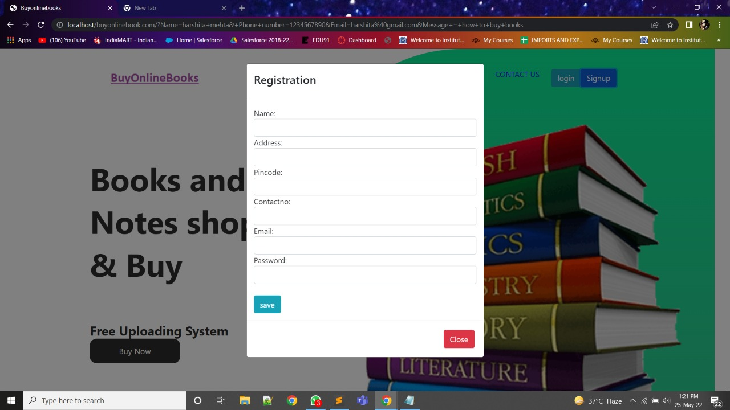

Slide 11
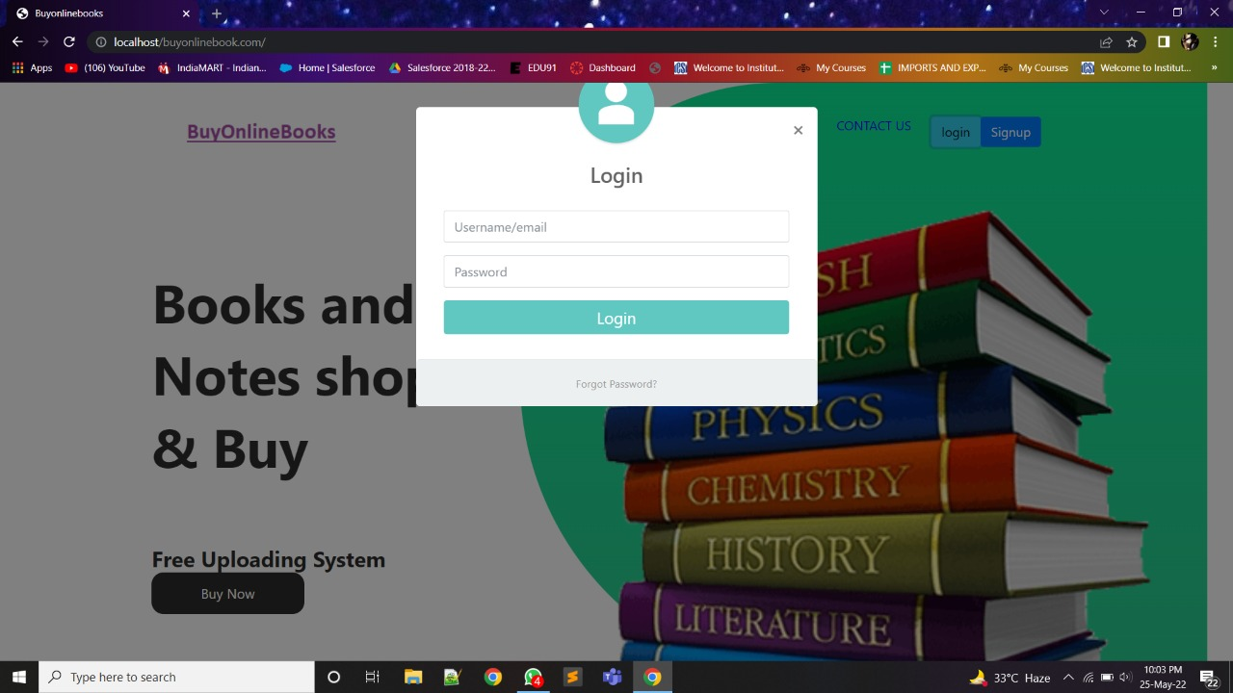

Slide 12
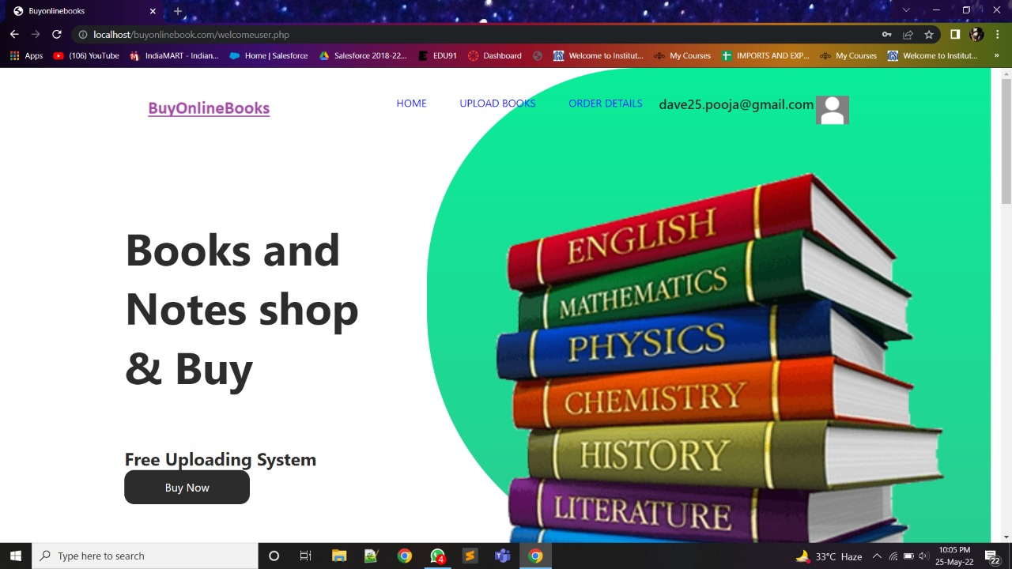

Slide 13
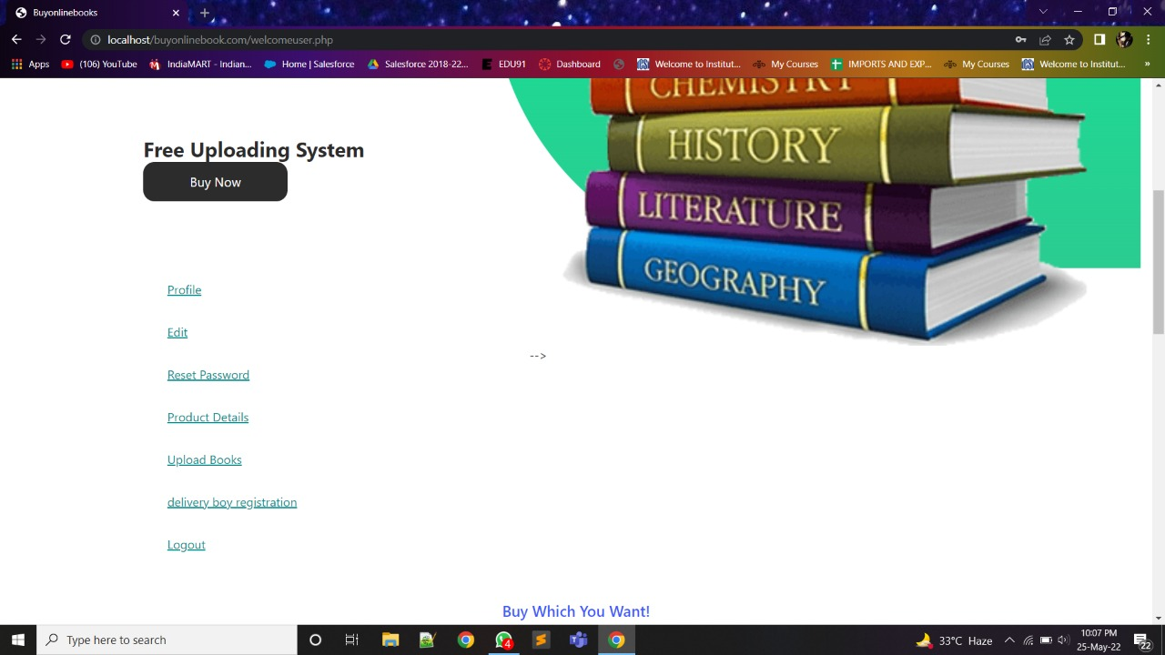

Slide 14
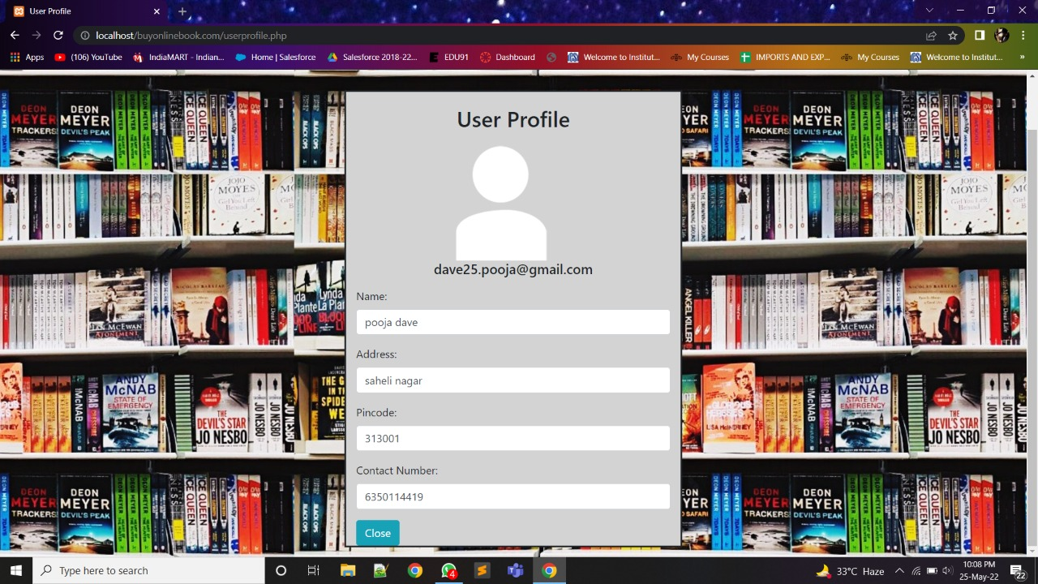
User Profile

Slide 15
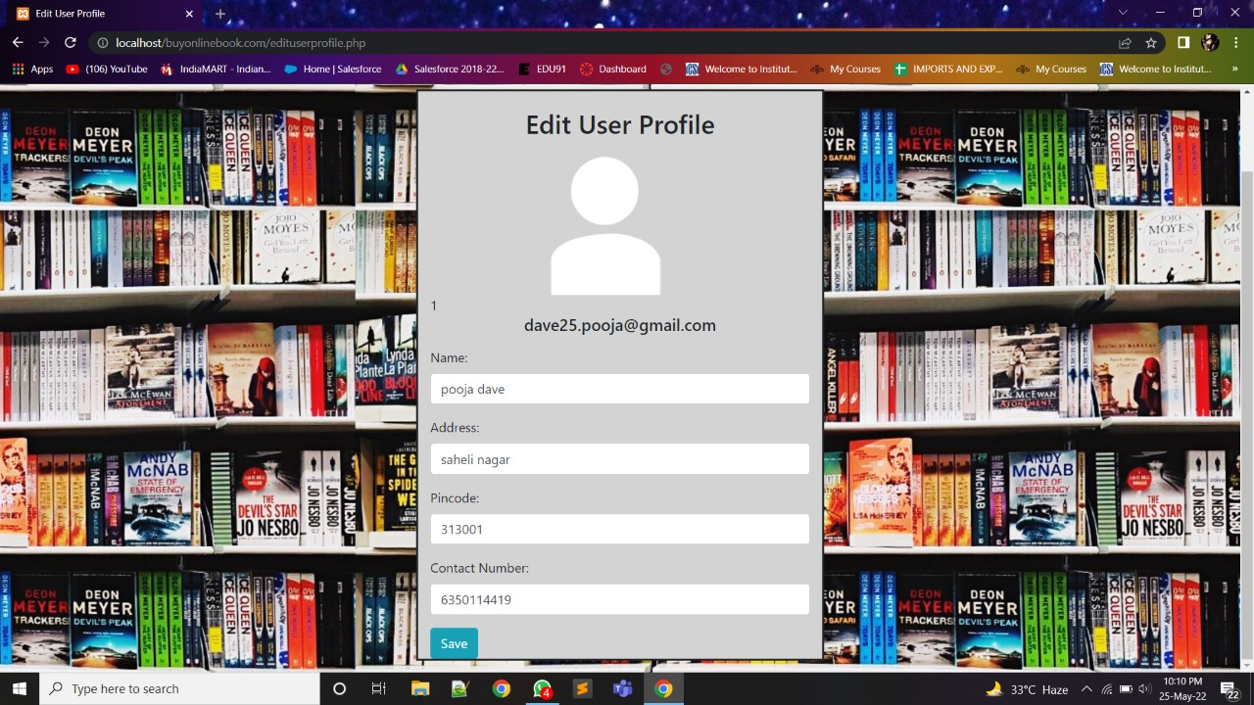
Edit User Profile

Slide 16
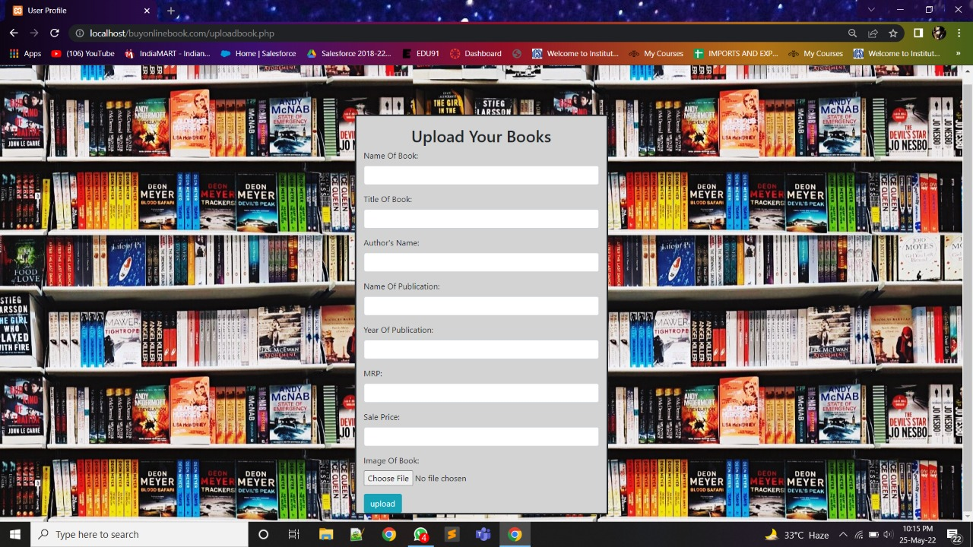
Upload Books

Slide 17
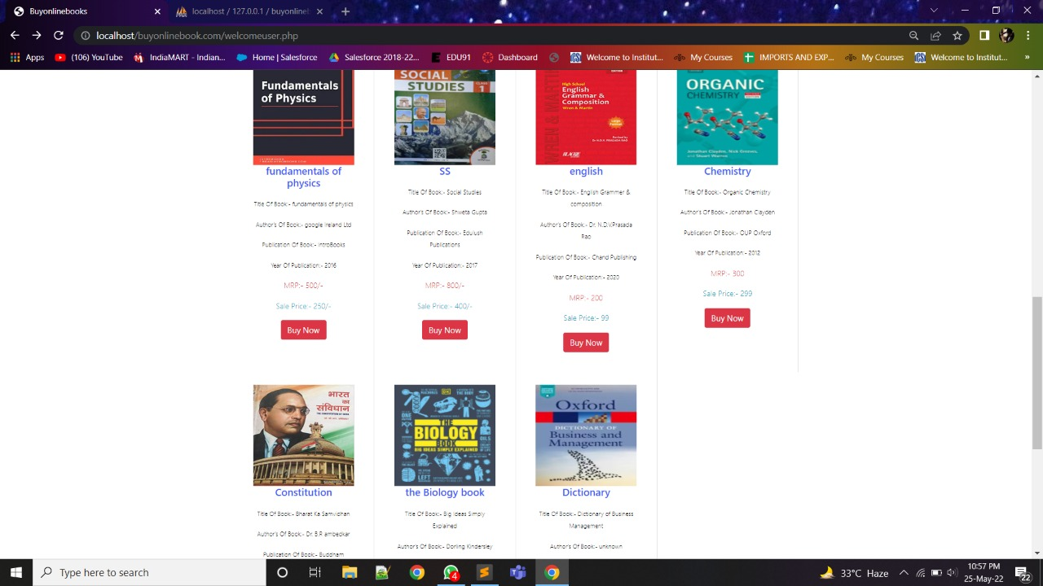
Bootstrap cards

Slide 18
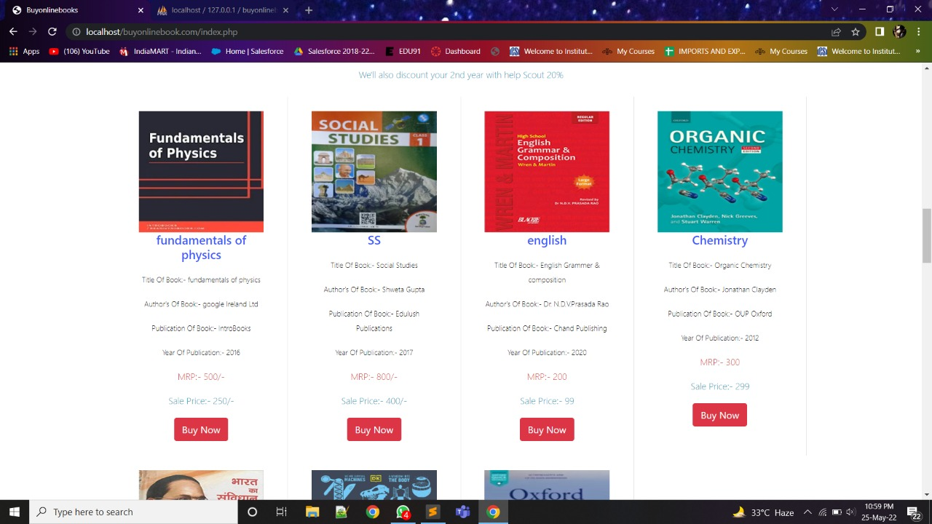
Books Details

Slide 19
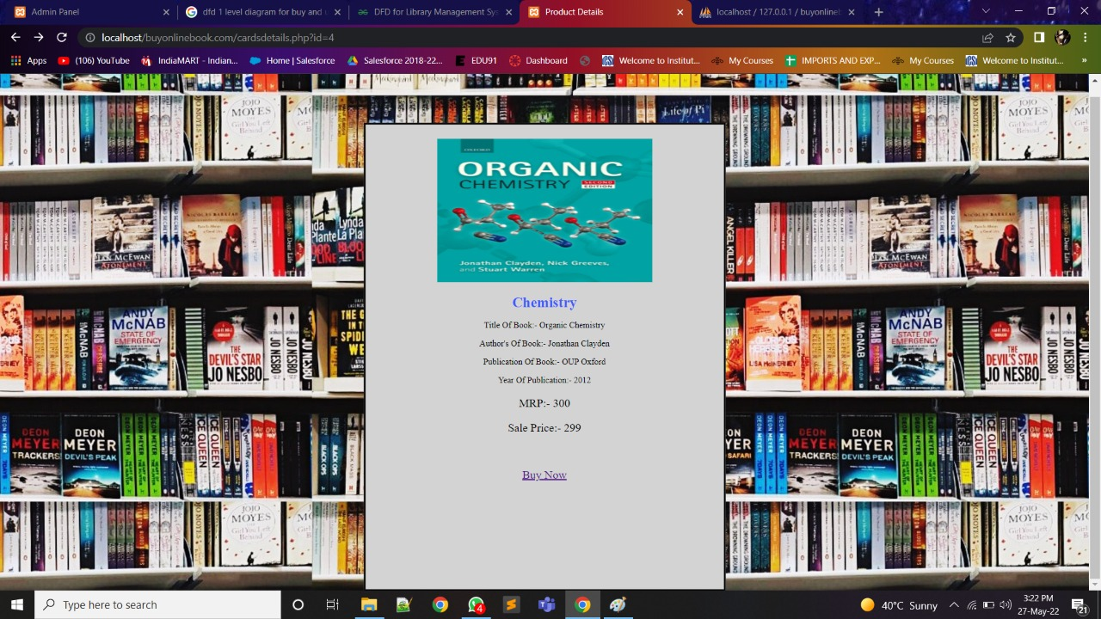

Slide 20
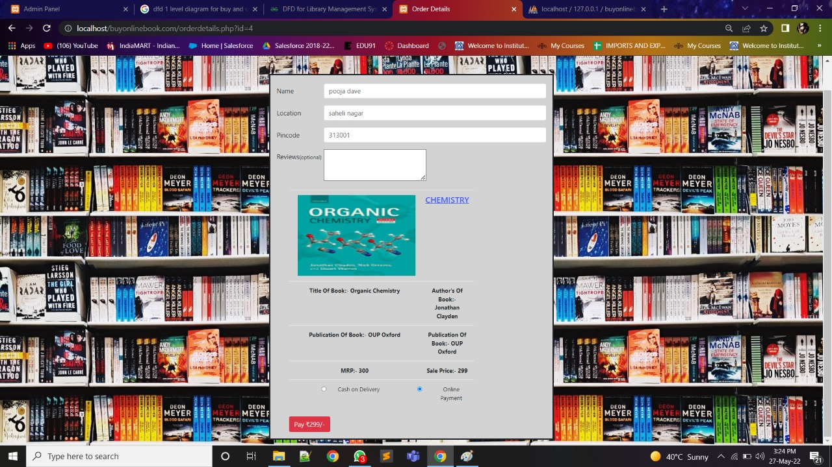

Slide 21
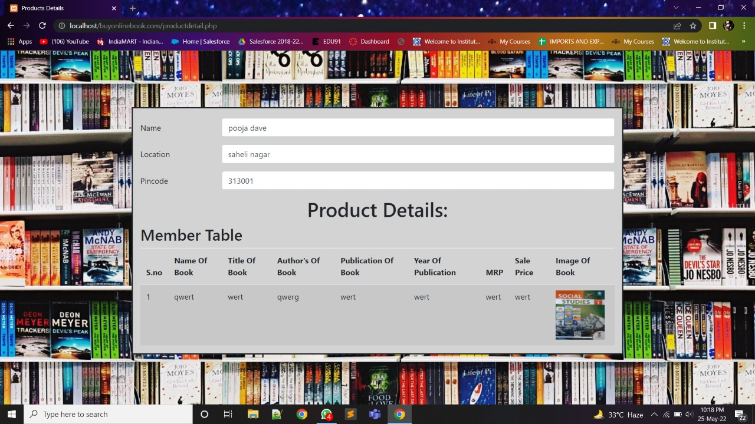
User Product Order Details

Slide 22
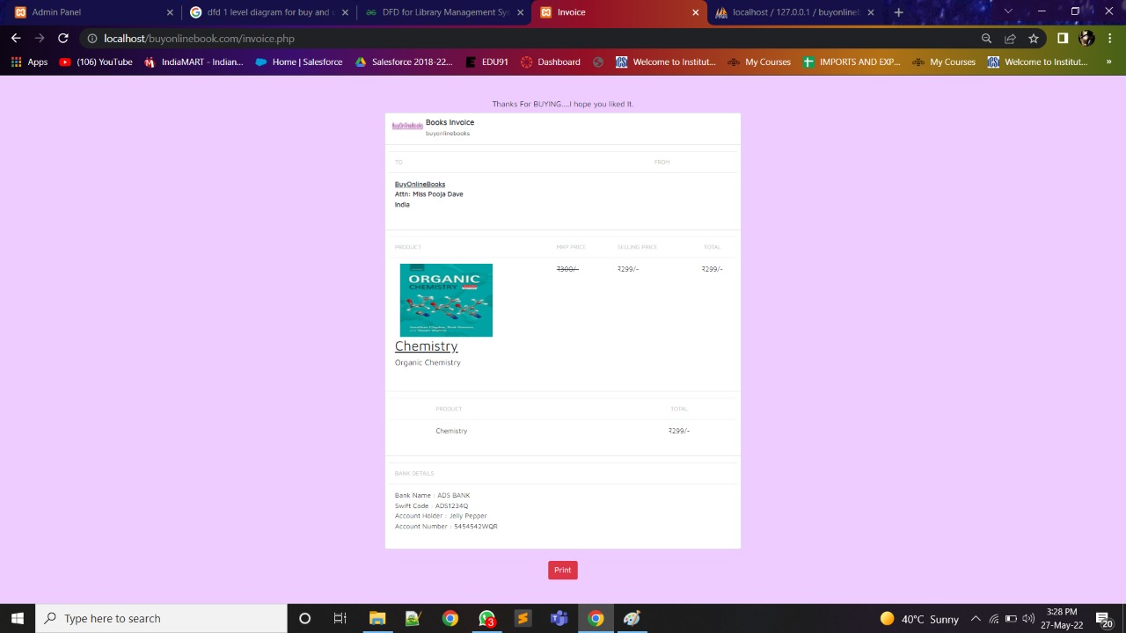

Slide 23
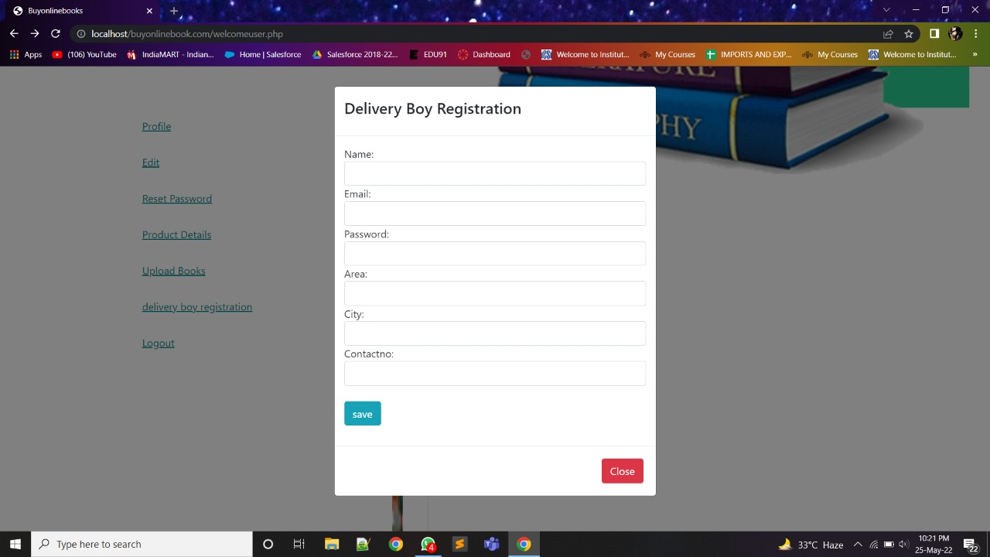
Delivery boy registration

Slide 24
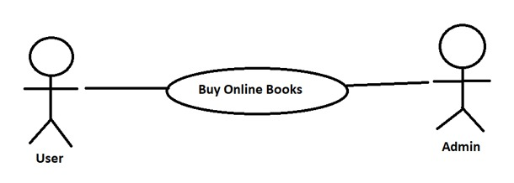
Use Cases
A) User access Home Page
In User access home page both user and admin can access the home page.

Slide 25
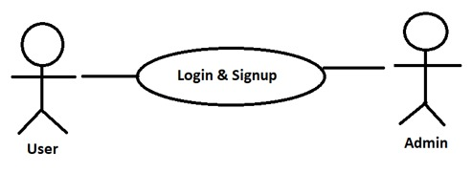
Use Cases
B) User Login Or Signup

Slide 26
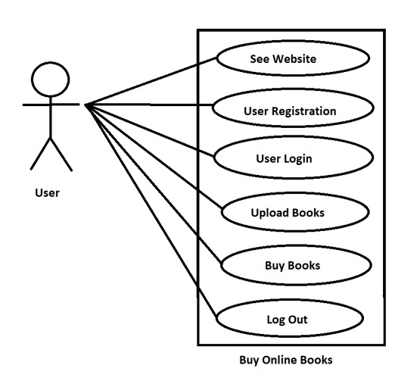
Use Cases
C) User use case: user activities

Slide 27
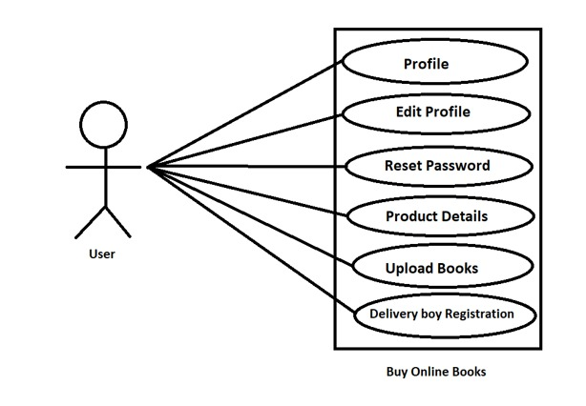
Use Cases
D) User select categories

Slide 28
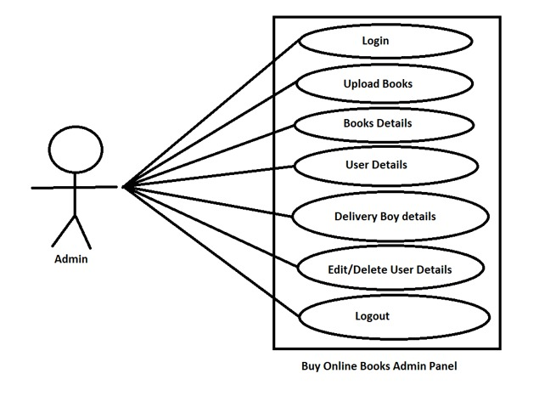
Use Cases
E)Admin use case admin panel

Slide 29
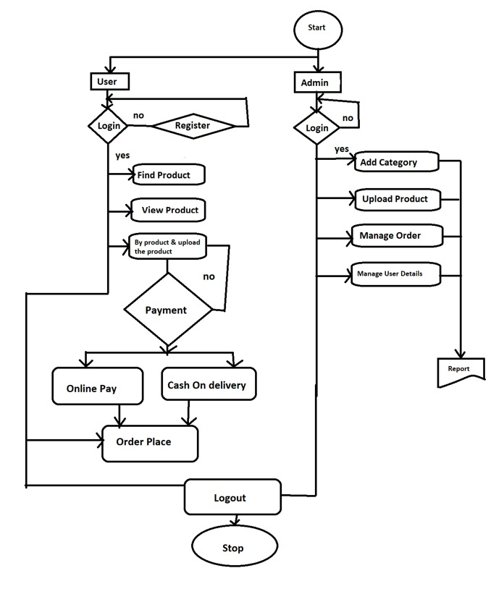
Flow Chart Diagram

Slide 30
Software requirements
Operating System : Windows
Technology : PHP
Web technologies : Html, JavaScript, CSS, Bootstrap5
IDE : notepad++ , Sublime Text
Web Server : Apache ( Xampp )
Database : MySQL

Slide 31
School
Public Libraries
Universities
Community Libraries
Institutions
Applications

Slide 32
This project in near future will provide facilities for generating online request and quick response for book access and upload for world wide users. In future time user can not only access books but also magazines, articles, writeups, short stories by upcoming authors and publishers.
It will provide a best platform to those people who are beginners and want to develop their carrier in these fields.
Future Scope

Slide 33
Thank you..!

